Slide 1
Storage Fundamentals 2
Group Members
Khondaker Tasnia Hoque (1205)
Sifat Sikder (1221)
Nazmul Hasan Rupu (1272)

Slide 2
Object Storage
01
Data storage architecture for storing unstructured data
Sections data into units as objects
Stores them in a structurally flat data environment.
Each object includes the data, metadata, and a unique identifier that applications can use for easy access and retrieval.

Slide 3
Unstructured Data
Unstructured data is information that is not arranged according to a preset data model or schema, and therefore cannot be stored in a traditional relational database or RDBMS.
Examples :
Text
Multimedia
Messages
Videos
Photos
Audio files.

Slide 4
Flat Data Environment
Flat file databases store plain text records and binary files that are needed for a specific purpose in a single directory for easy access and transfer.
A flat file is a collection of data stored in a two-dimensional database in which similar yet discrete strings of information are stored as records in a table. The columns of the table represent one dimension of the database, while each row is a separate record.

Slide 5
How Does It Work
With object storage, the data blocks of a file are kept together as an object, together with its relevant metadata and a custom identifier, and placed in a flat data environment known as a storage pool.
When you want to access data, object storage systems will use the unique identifier and the metadata to find the object you need, such as an image or audio file.
You can also customize metadata, allowing you to add more context that is useful for other purposes, such as retrieval for data analytics.
You can locate and access objects using RESTful APIs, HTTP, and HTTPS to query object metadata. Since objects are stored in a global storage pool, it’s fast and easy to locate the exact data you need.

Slide 6
File vs Block vs Object Data Storage
File Storage
Structure | File storage organizes data into files and folders, resembling a traditional file system. It uses a hierarchical structure, where files are stored in directories.
Use Cases | File storage is suitable for shared file systems, home directories, and network-attached storage (NAS) solutions. It is commonly used for collaborative work, file sharing, and general-purpose file storage.
Scalability | Scalability can be limited when compared to object storage, especially in large-scale deployments.
Examples | Windows File Server, NFS-based NAS solutions.

Slide 7
File vs Block vs Object Data Storage
Block Storage
Structure | Block storage divides data into fixed-sized blocks and manages them as individual storage volumes. It doesn't have a file hierarchy or structure.
Use Cases | Block storage is commonly used for databases, virtual machines (VMs), and applications that require low-level access to storage. It provides high-performance storage but lacks the data management features of file and object storage.
Scalability | Scalability can be achieved by adding more blocks or volumes, but management can be complex at scale
Examples | Storage Area Networks (SANs), Amazon Elastic Block Store (EBS).

Slide 8
File vs Block vs Object Data Storage
Object Storage
Structure | Object storage stores data as objects, each with its unique identifier, metadata, and data. Objects are organized in a flat namespace without a traditional file hierarchy.
Use Cases | File storage is suitable for shared file systems, home directories, and network-attached storage (NAS) solutions. It is commonly used for collaborative work, file sharing, and general-purpose file storage.
Scalability | Object storage is ideal for storing and managing vast amounts of unstructured data, such as media files, backups, archives, and data used by cloud-native applications. Highly scalable.
Examples | Amazon S3, Google Cloud Storage, and various on-premises object storage solutions.

Slide 9
What are the benefits of object storage?
Massive scalability
Reduced complexity
Searchability
Cost efficiency
01
02
03
04

Slide 10
Wide Column Database
02
A type of NoSQL database that stores data in a column-family format
Organizes data in a way that allows for a more efficient storage of data and faster query performance.
Well suited for data warehousing and business intelligence applications

Slide 11
NoSQL Database
NoSQL databases (aka "not only SQL") are non-tabular databases and store data differently than relational tables.
Example : MongoDB

Slide 12
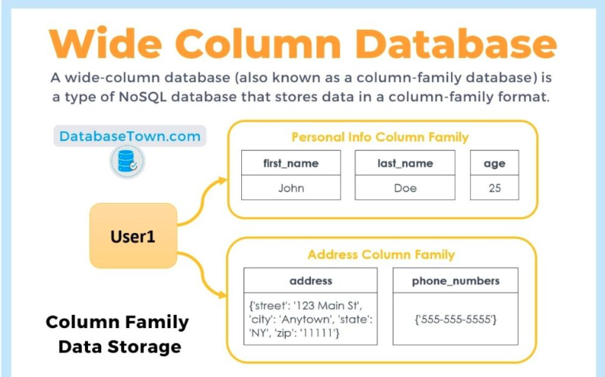
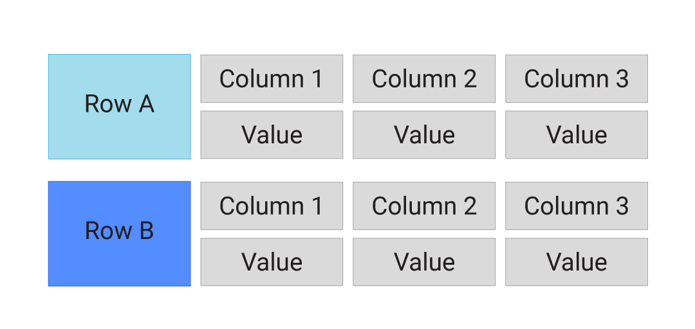

Slide 13
Wide-column database use cases
Big data
Data Warehousing
OLAP (Online Analytical Processing)
Real-time analytics
Cloud-based analytics
IoT (Internet of things)

Slide 14
What are the benefits of Wide Column Database
Scalability
Schema Flexibility
High Write Throughput
Availability and Fault Tolerance
NoSQL Features
01
02
03
04
05

Slide 15
What are the disadvantages of Wide Column Database
Complex Querying
Data Modeling Challenges
Size Overhead
Less Mature Ecosystem
Limited Querying Capabilities
01
02
03
04
05

Slide 16
Example-Cassandra
No master or slave nodes
Nodes are logically distributed like a ring.
Data is automatically distributed across all the nodes
Data is kept in memory and lazily written to the disk

Slide 17
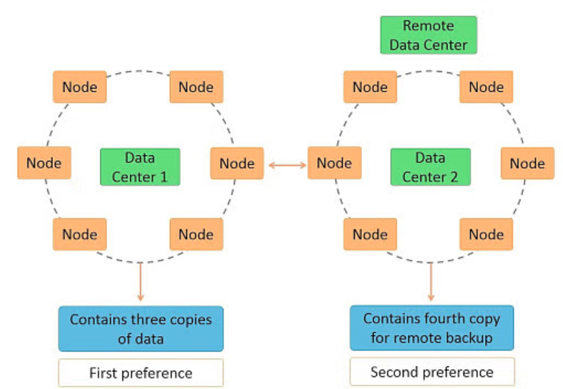
Example-Cassandra Architechture

Slide 18
Time Series database
03
Time series data is a sequence of data points indexed in time order.
A time series database is a type of database specifically designed for handling time-stamped or time-series data.
Data points typically consist of successive measurements made from the same source over a fixed time interval
Used to track change over time.

Slide 19
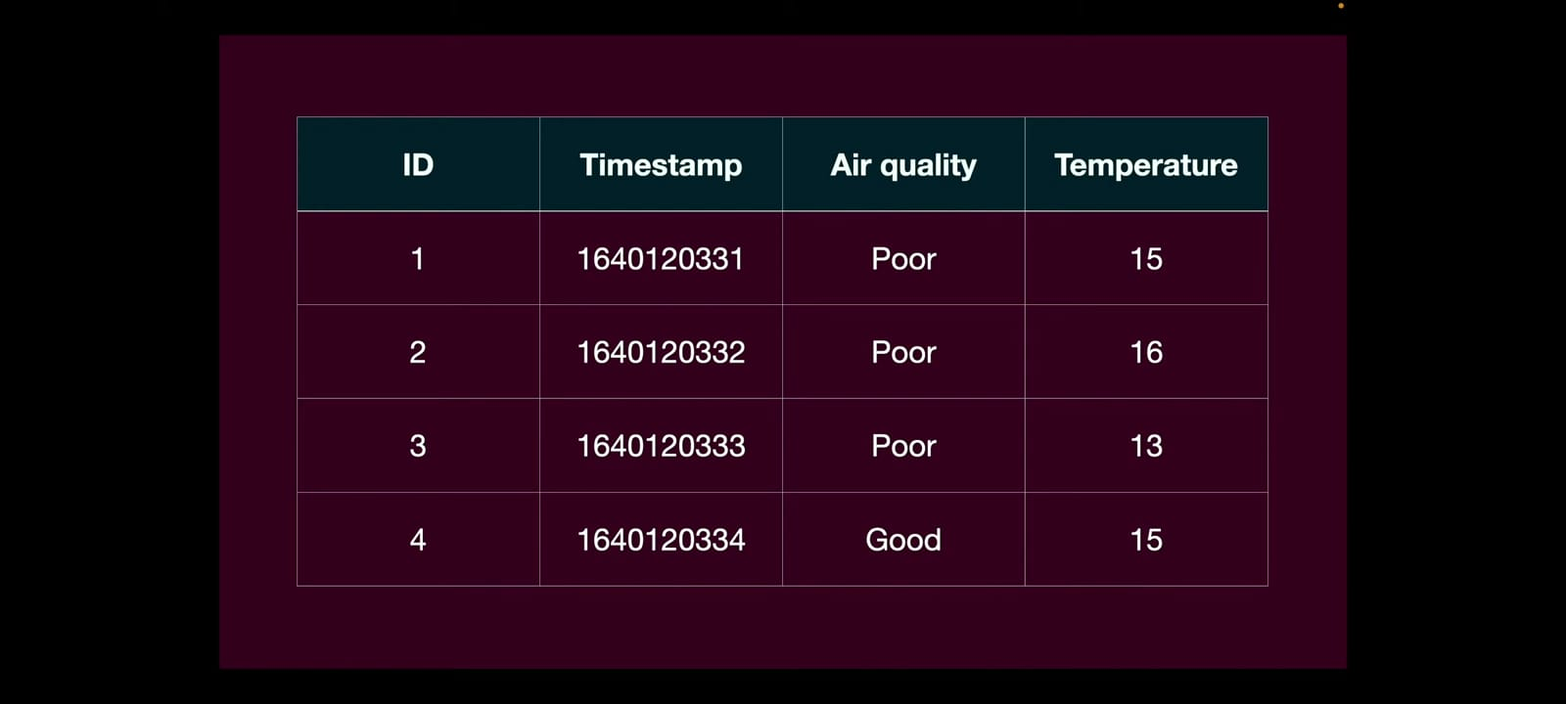
Time Series Database-Demo

Slide 20
Examples
Electrical activity in the brain
Stock prices
Sensor data
Weather data
Website activity data

Slide 21
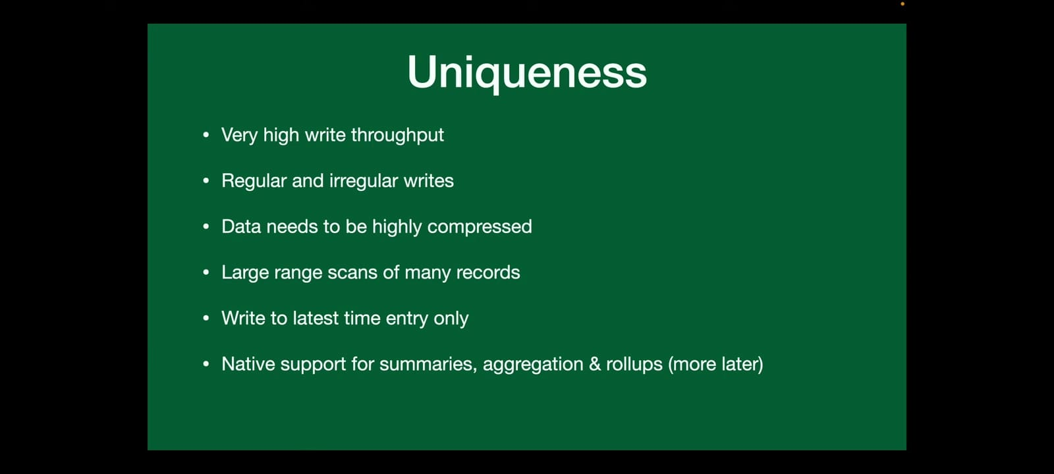

Slide 22
What are the Advantages of Time Series Database
Efficient Data Storage
Fast Data Retrieval
Scalability
Data Retention Policies
Built-in Time-Series Functions
01
02
03
04
05

Slide 23
What are the Disadvantages of Time Series Database
Niche Use Case
High Cost
Limited General-Purpose Features
01
02
03

Slide 24
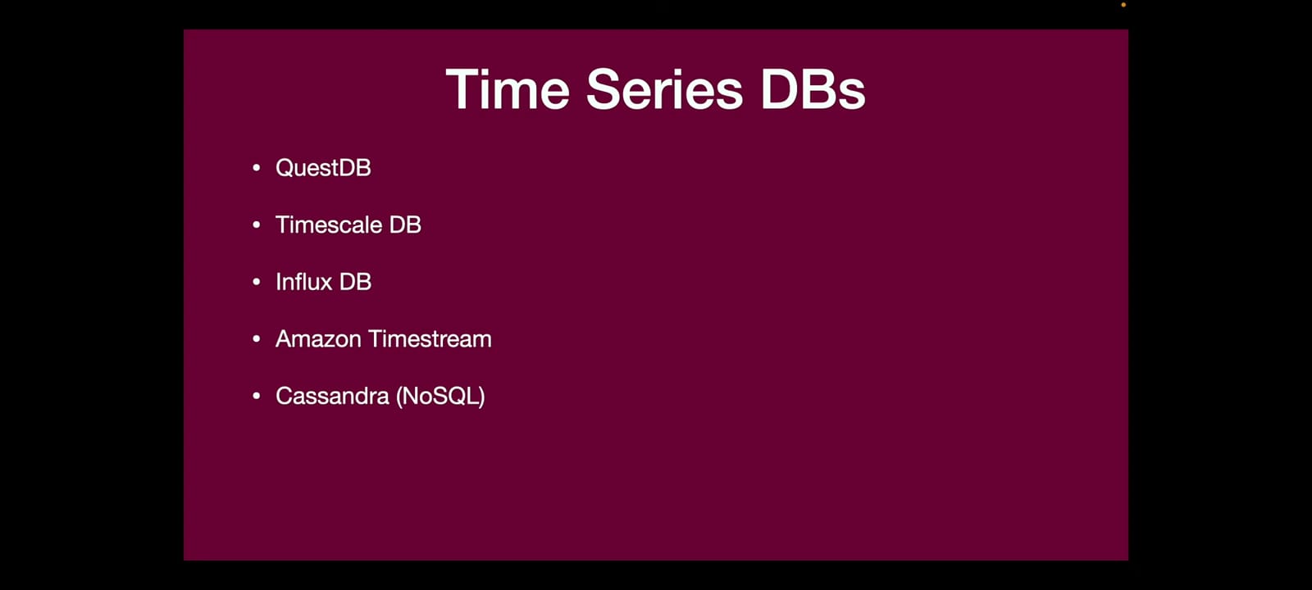

Slide 25
Example- InfluxDB
Written in GO language
Optimized for fast storage and retrieval of time
Schema less database
Tables of RDBMS are known by measurements in influxDB

Slide 26
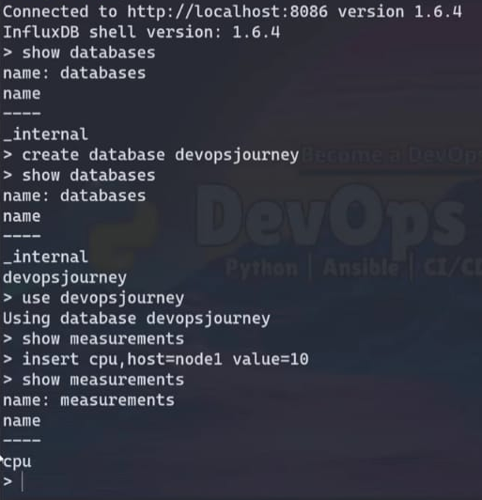
Example- InfluxDB-Cont.

Slide 27
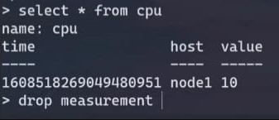
Example- InfluxDB-Cont.

Slide 28
Graph database
04
A graph database (GDB) is a database that uses graph structures for semantic queries with nodes, edges, and properties to represent and store data.
Nodes typically store information about entities (people, places, or various things) which are stored into relational databases
Edges store information about the relationship between nodes

Slide 29
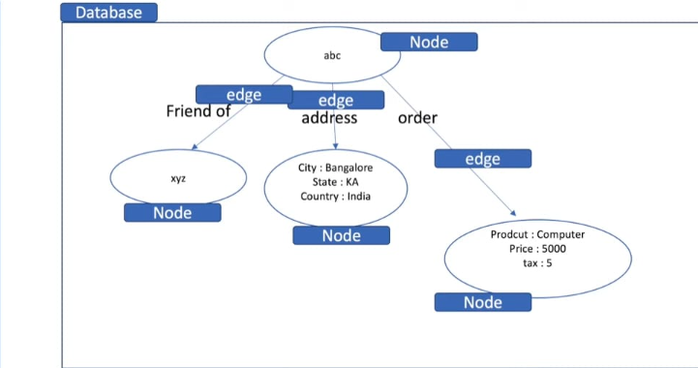
Example

Slide 30

Example-2

Slide 31
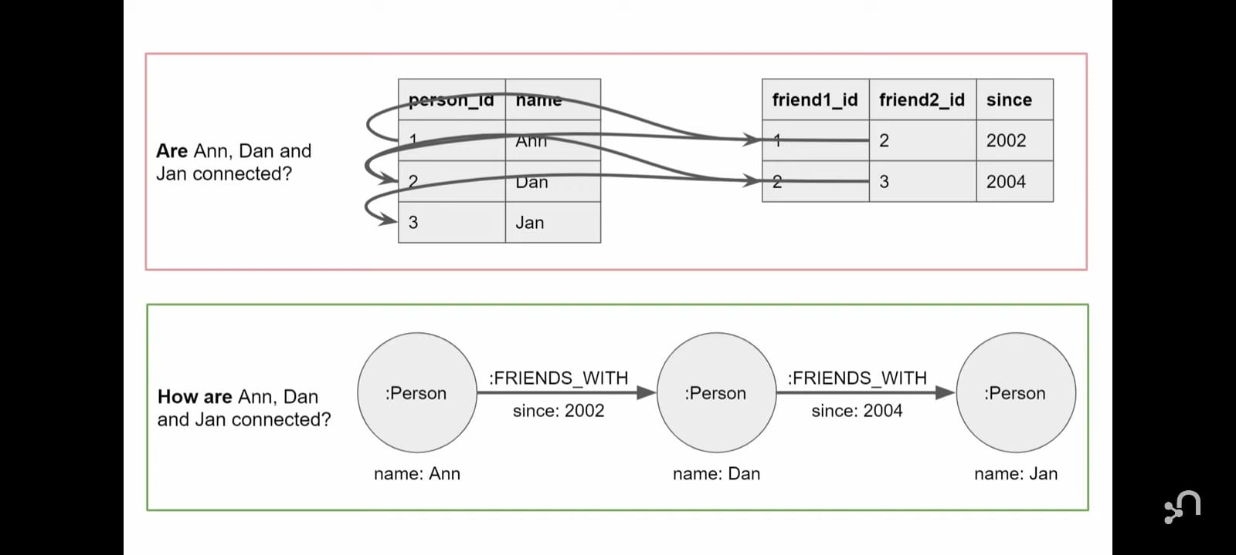
Graph Database vs RDBMS

Slide 32
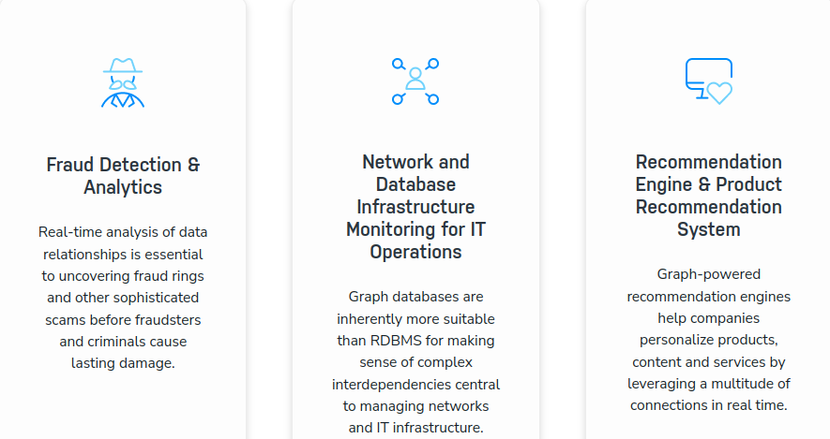
Use Cases

Slide 33
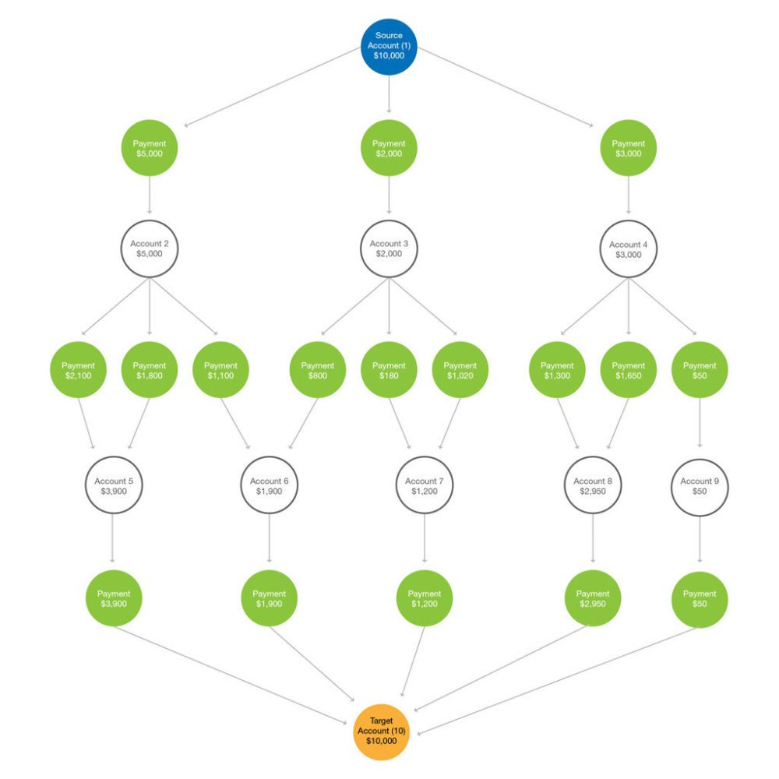
Fraud Detection

Slide 34
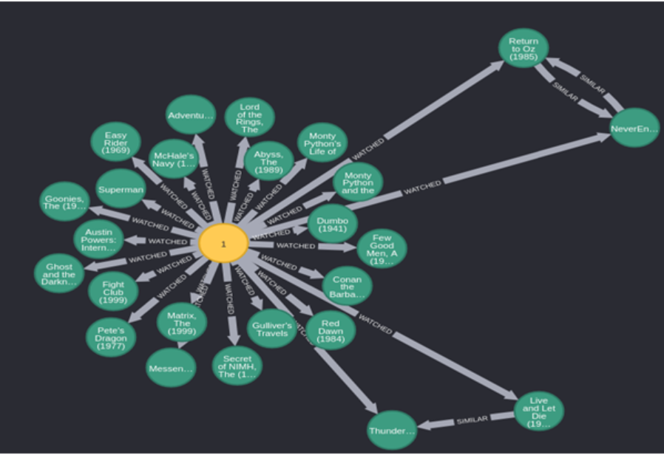
Recommendation

Slide 35
Types of Graph Database
property graphs : The property graph focuses on analytics and querying
RDF graphs: RDF graph emphasizes data integration.

Slide 36
Pros and Cons of Graph Database
Pros | Cons
Efficient for Complex Relationships | Performance Degradation with High Node Degrees
High Performance | Storage Overhead for Dense Graphs
Flexible Schema and scalability | Indexing Complexity
Natural Representation | High Cost

Slide 37
Example-Neo4j
Creating a Node: CREATE (srk:User{name:"Shah Rukh Khan"})
Updating a Node:
match (nila:User {name:"Nila"})
set nila.name= "Mim"
Creating a Relation:
match (thor:User {name:"Thor"}), (ironman:User {name:"tony stark"})
create (thor) - [:isFriendOf] -> (ironman)
Delete a Node:
match (srk:User)
where id(srk) = 5
detach delete srk

Slide 38
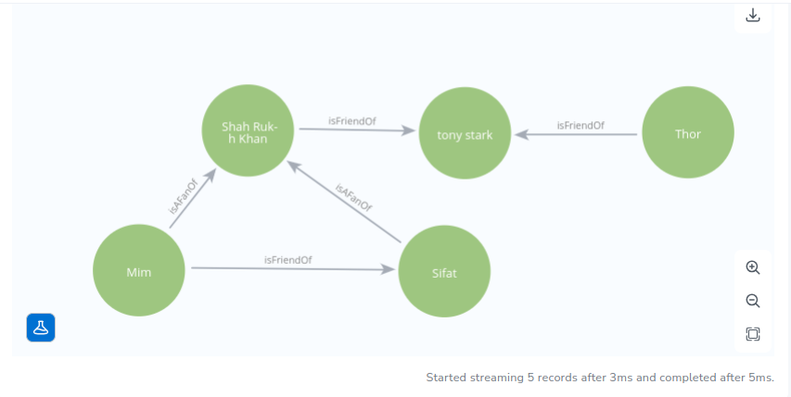
Example-Neo4j-Created Graph

Slide 39
THANK YOU!!!

